Slide 1
Faculty:
Chidananda Acharya
Contact Details:
Email-id: Chidananda.acharya@manipal.edu
Mob No. 9972994887

Slide 2
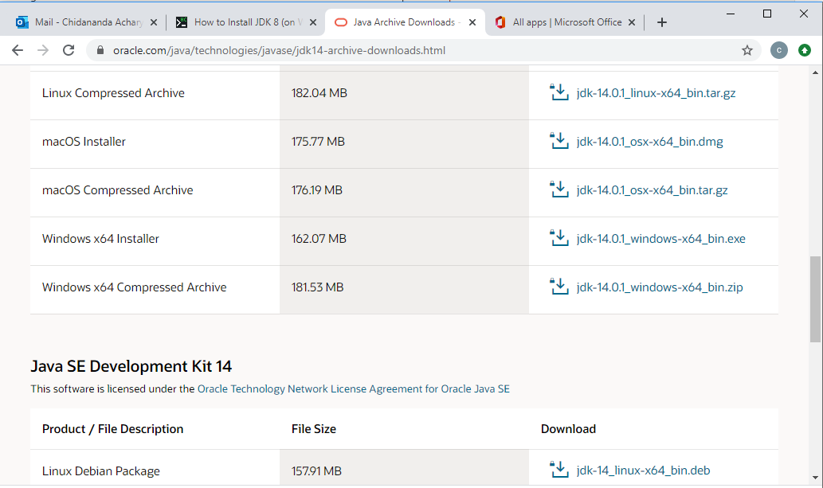
Select windowsx64 installer and download. Run that. Java will be installed.

Slide 3
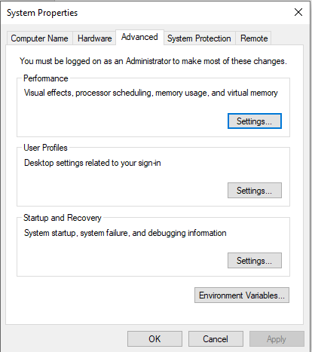
In the start type environment variables and open. The below window will open.
Here select environment variables and the next window will open.

Slide 4
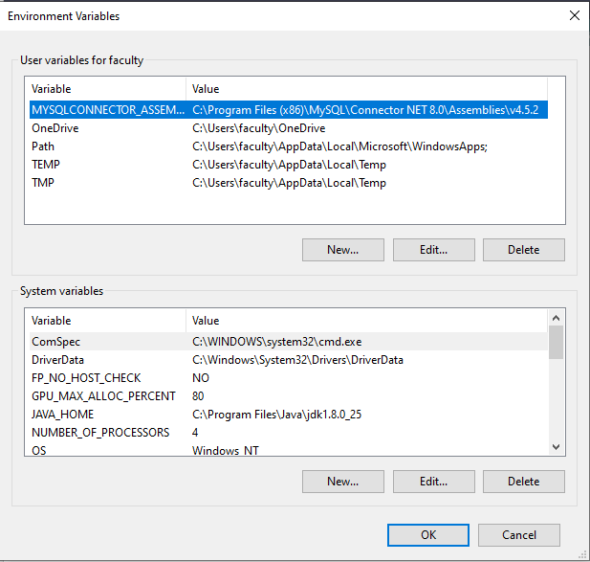
Here in system variables, select path and click edit.

Slide 5
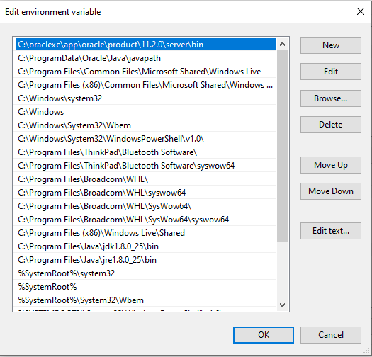
Here click “new”. Then paste the path of jdk bin which will be like
“C:\Program Files\java\jdk14\bin” and click “ok”
Now when you type “java” in command prompt, it will display the details of java if java is properly installed, otherwise “ not a recognized internal command”.

Slide 6
Write a method largest to find the maximum of three numbers. Also write a main method to read 3 numbers and find the largest among them using this method.

Slide 7
OOP: Syllabus
Introduction to OOP (12 Hrs)
Inheritance, Interfaces and Packages (10 Hrs)
Exception Handling and Multithreading (10 Hrs)
Generics and GUI with Javafx (12 Hrs)
CERT JAVA Coding Standard (4 Hrs)

Slide 8
Chapter 1
Java Programming Fundamentals
Copyright © 2013 by The McGraw-Hill Companies, Inc. All rights reserved.

Slide 9
Programming Languages
High-level languages are easy for humans to read and write (e.g.,C, C++ Java).
Low-level languages are closer to the hardware (e.g., machine or object code).
Compilers are programs that translate high-level languages into object code.
Copyright © 2013 by The McGraw-Hill Companies, Inc. All rights reserved.

Slide 10
The Origins of Java
Java is a high-level language conceived by James Gosling in 1991.
  Initially called “Oak”, but was renamed “Java” in 1995.
Java syntax is similar to the older languages C & C++.
  It was not designed to replace C++.
Original motivation – need for a platform-independent language for creating s/w to be embedded in various consumer electronic devices / Internet
  The latest version is Java SE 14.
Copyright © 2013 by The McGraw-Hill Companies, Inc. All rights reserved.

Slide 11
Progress Check
Java is useful for the Internet because it can be produce ______ programs
Java is the direct descendant of what languages?

Slide 12
Java Buzzwords
Simple
  easy to learn, inherits c/c++ syntax, left out difficult constructs like pointers, memory management.
Pure Object oriented Language-
  classes and objects
Java is case sensitive language-
  variable val is different from Val, VAL, VaL
Robust-
  Ability to create robust, reliable programs
Exception handling
Strictly typed language
( checks for errors at both compile and run time)
Easy memory management
( automatic deallocation-garbage collection)

Slide 13
Java Buzzwords
Multi threaded
  write programs that do many things simultaneously
Architecture neutral
  compiled java programs will run on variety of processors using various OSs (The goal- “ Write once, run any where, any time, forever”)
Both compiled and interpreted
  enables creation of cross-platform programs

Slide 14
Java Buzzwords
Dynamic
  Resolves type information at run time
Distributed
  Designed for distributed environment of internet because it handles TCP/IP protocol, RMI
Security-
  Execution is confined to JVM

Slide 15
Java and Internet
Java can be used to create two types of programs: applications and applets
An application is a program
  that runs on your computer, under the operating system of that computer
An applet is a tiny Java program
  designed to be transmitted over the Internet
  automatically downloaded across the network, just like an image, sound file, or video clip
  executed by a Java-compatible Web browser

Slide 16
Applets
Applets
  Allow some functionality to be moved from server to client like
  display data provided by the server
  handle user inputs
  provide simple functions ( loan calculator)
  that execute locally rather than on server
  Challenges: Introduces security and portability issues

Slide 17
SECURITY
Automatic downloading of applets might contain virus
  malicious code gains unauthorized access to system resources, passwords, credit card numbers etc.
But, when a Java-compatible Web browser used,
  One can safely download Java applets without fear of viral infection or malicious intent
Java achieves this protection
  by confining a Java program to the Java execution environment and
  not allowing access to other parts of the computer environment

Slide 18
Portability
Portability is the major aspect of Internet
  because many different types of computers and OSs are connected to it.
In case of applets,
  must be able to downloaded and must be executed by wide variety of computes and OSs.
Because Java is architecture neutral,
  Java programs are portable.
  They can be run on any platform without being recompiled.

Slide 19
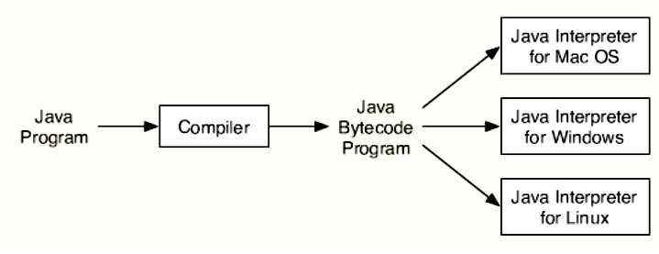
Java’s solution:
Execution of bytecode by JVM
  is the easiest way to create portable programs by implementing java interpreter for each platform.

Slide 20
Java bytecode
The output of a Java compiler(javac) is
  not executable code ; rather, it is bytecode
Bytecode is a highly optimized set of instructions
  designed to be executed by the Java run-time system, Java Virtual Machine (JVM)

Slide 21

The Bytecode Advantage
Java runtime
(Windows)
javac (Windows)
Java runtime
(Mac)
javac (Mac)
Java code
(.java file)
Java bytecode
(.class file)
Java runtime
(Linux)
javac (Linux)

Slide 22

A Picture is Worth…
Java’s solution:
The output of the compiler is .class file
The Interpreter's are sometimes referred to as Java Virtual Machines

Slide 23
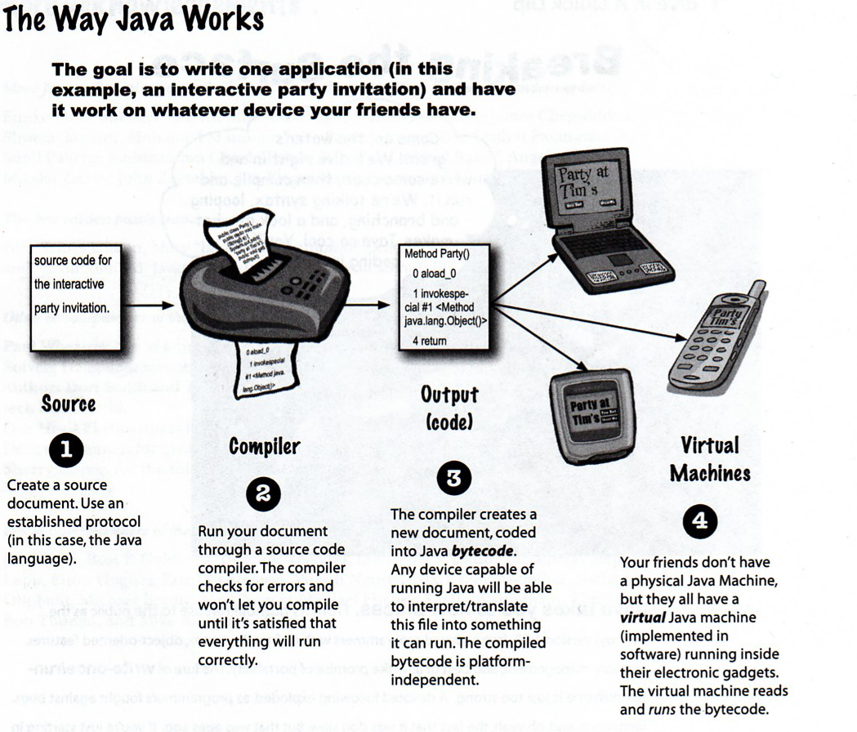
August 6, 2009

Slide 24
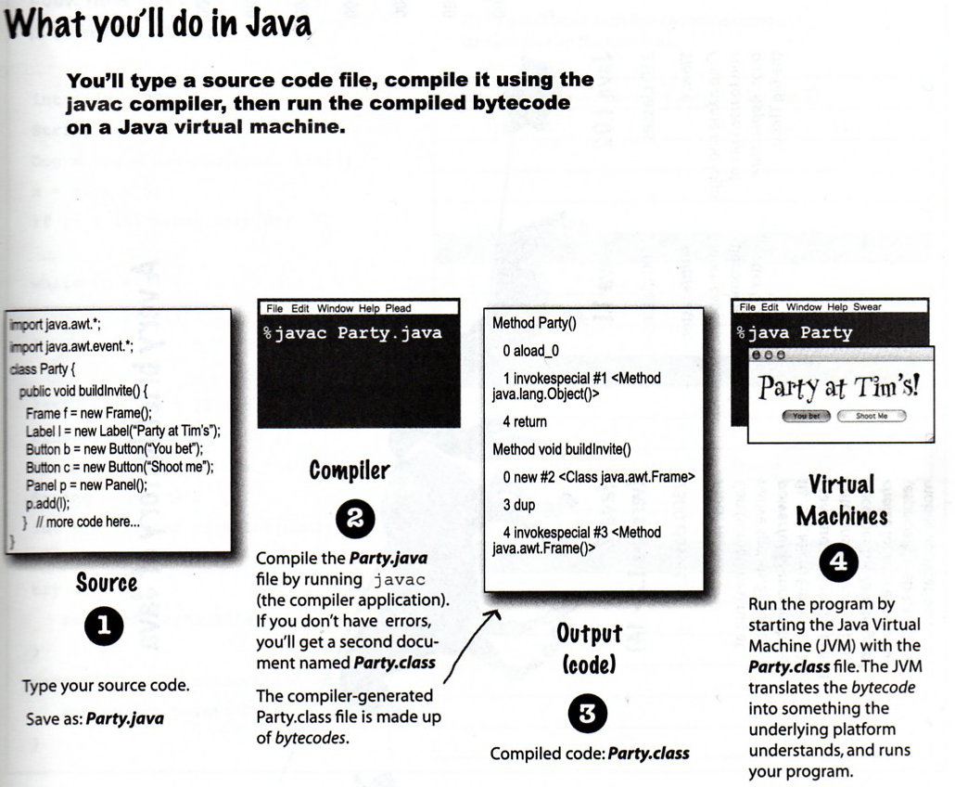
August 6, 2009

Slide 25
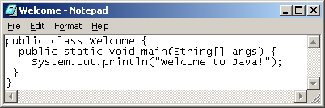
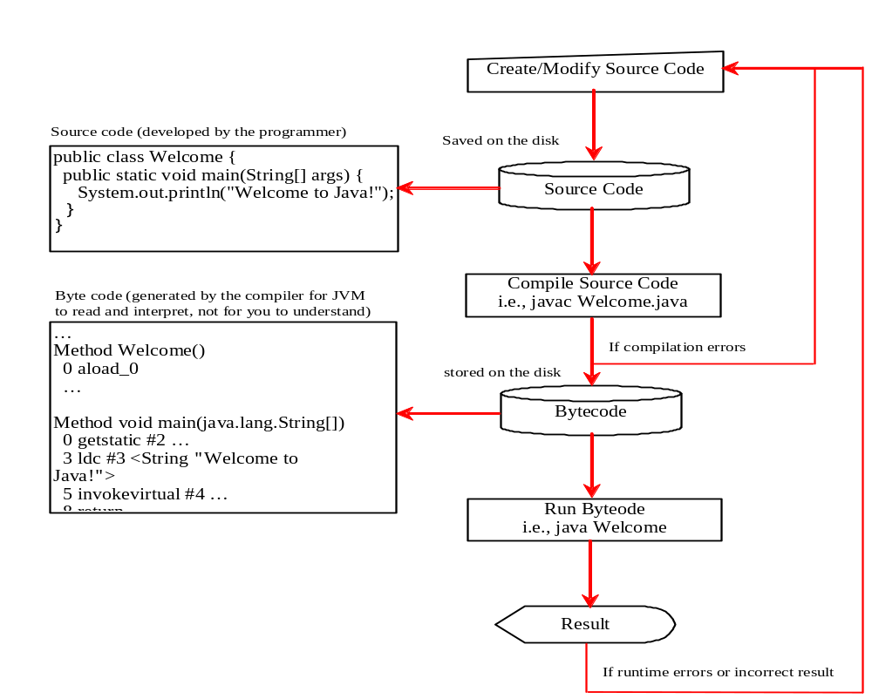
Creating, Compiling, and Running Programs

Slide 26
Java Compilers and the JVM
Java compilers do not generate machine code for a CPU.
Java compilers generate machine code for the JVM (Java Virtual Machine).
The JVM machine code (called bytecode) is executed by a JVM interpreter program on each computer.
Copyright © 2013 by The McGraw-Hill Companies, Inc. All rights reserved.

Slide 27
Java Runtime Environment (JRE)
a set of programming tools for developing Java applications:
  Java Virtual Machine (JVM),
  core classes ( libraries),
  supporting files.

Slide 28
Just –in-time Compiler(JIT)
When JIT is part of JVM
  Selected portions of bytecode are compiled into executable code at run time
    On a piece-by-piece, demand basis
  It does not compile an entire java program
  Furthermore, not all sequences of bytecode are compiled
    only those that will benefit from compilation
  JVM is part of Java run-time system, JRE, Jave Runtime Environment

Slide 29
Progress Check
What is an applet?
What is a Java bytecode?
Which two internet programming problems can be solved using bytycode?

Slide 30
Object-Oriented Programming
In POP. Programs are organized around code
( code acting on data)
In OOP, code is organized around the data.
(data controlling access to code)
In OOP, we define the data and the routines that are permitted to act on the data.
In Java, a class encapsulates the data and the routines acting on the data.
Copyright © 2013 by The McGraw-Hill Companies, Inc. All rights reserved.

Slide 31
The Key traits of Object Oriented Programming
Encapsulation
Polymorphism
Inheritance

Slide 32
Encapsulation
Encapsulation - is the mechanism
  that binds together code and the data it manipulates,
  and keeps both safe from outside interference and misuse
Encapsulation
  Self-contained black box
  Object supports encapsulation
Encapsulation: Java
  Basic Unit of Encapsulation: Class
  Object: An instance of Class
  Clasa Members: Instance variables and methods

Slide 33
Polymorphism
Polymorphism - is a feature that
  allows one interface to be used for a general class of actions.
  The specific action is determined by the exact nature of the situation.
Example”
  get method – to retrieve next item from the list
    List: FIFO, FILO, Based on some priority
In general
  One interface, multiple methods
    A generic interface to a group of related activities
Helps to reduce complexity
  Compiler should select specific action as it applies to each situation

Slide 34
Inheritance
Inheritance - the process by which one object can acquire the properties of another object
Supports Hierarchical(top-down) classification
  Example: Food <– Fruit <– Apple <– Red Delicious Apple
Using Inheritance
  An object need only define its unique qualities
    It can inherit its general attributes from its parent

Slide 35
Progress Check
Name of the principles of OOP?
What is the basic unit of encapsulation in Java?

Slide 36
The Java Development Kit (JDK)
To compile and run java programs JDK must be installed in the m/c, which can be downloaded using the below link
www.oracle.com/technetwork/java/javase/downloads/index.html
Provide two primary programs
Java compiler: javac
Application launcher or java interpreter : java
It runs in the command prompt environment
and use command line tools

Slide 37
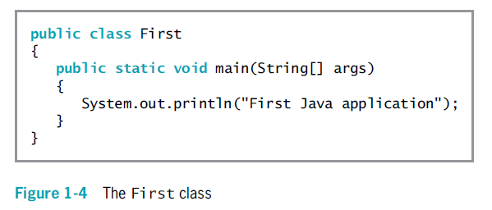

Slide 38
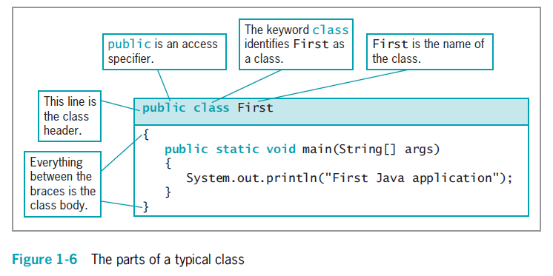

Slide 39
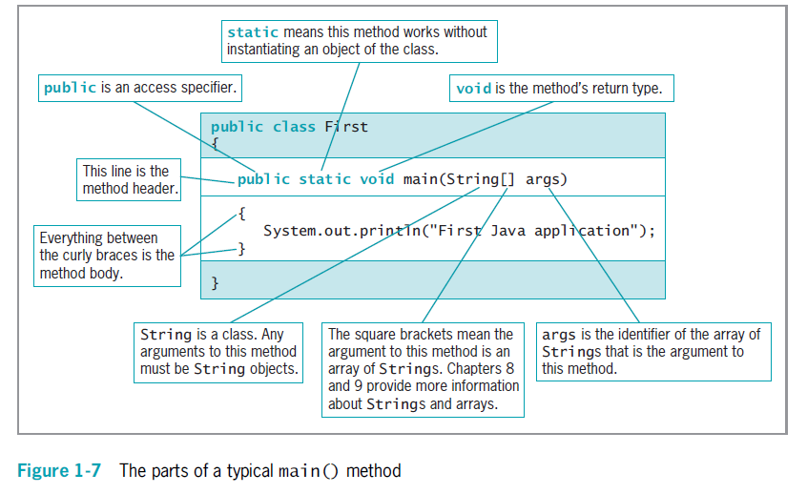

Slide 40
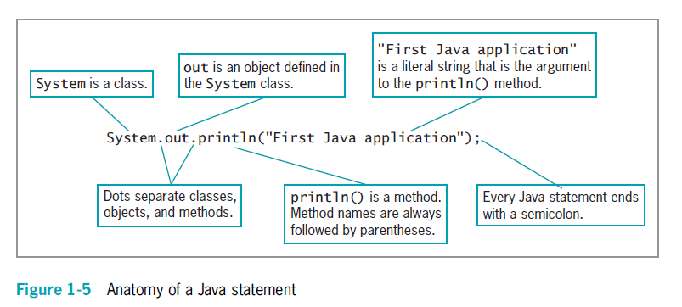

Slide 41
Comments: Single vs Multi-line
/*
This is a simple Java program.
Call this file Example.java.
*/
Public class Example {
// A Java program begins with a call to main().
public static void main(String[] args) {
System.out.println("Java drives the Web.");
}
}
Copyright © 2013 by The McGraw-Hill Companies, Inc. All rights reserved.

Slide 42
First Simple Java Program
/*
This is a simple Java program.
Call this file Example.java.
*/
Public class Example {
// A Java program begins with a call to main().
public static void main(String[] args) {
System.out.println("Java drives the Web.");
}
}
Copyright © 2013 by The McGraw-Hill Companies, Inc. All rights reserved.

Slide 43
When a class member is preceded by public, then that member may be accessed by code outside the class in which it is declared
The keyword static allows main( ) to be called without having to instantiate a particular instance of the class
The keyword void simply tells the compiler that main( ) does not return a value

Slide 44
Progress Check
Where does a Java program begin execution?
What does System.out.println() do
What is the name of the java compiler? What do you use to run java program?

Slide 45
A Second Example
class Example2 {
public static void main(String[] args) {
int var1; // this declares a variable
int var2; // this declares another variable
var1 = 1024; // this assigns 1024 to var1
System.out.println("var1 contains " + var1);
var2 = var1 / 2;
System.out.print("var2 contains var1 / 2: ");
System.out.println(var2);
}
}
Copyright © 2013 by The McGraw-Hill Companies, Inc. All rights reserved.

Slide 46
A Third Example
class Example3 {
public static void main(String[] args) {
int w; // declare an int variable
double x; // declare a floating-point variable
w = 10; // assign w the value 10
x = 10.0; // assign x the value 10.0
System.out.println("Original value of w: " + w);
System.out.println("Original value of x: " + x);
System.out.println(); // print a blank line
// now, divide both by 4
w = w / 4;
x = x / 4;
System.out.println("w after division: " + w);
System.out.println("x after division: " + x);
}
}
Copyright © 2013 by The McGraw-Hill Companies, Inc. All rights reserved.

Slide 47
Converting Gallons to Liters
class GalToLit {
public static void main(String[] args) {
double gallons; // holds the number of gallons
double liters; // holds conversion to liters
gallons = 10; // start with 10 gallons
liters = gallons * 3.7854; // convert to liters
System.out.println(gallons + " gallons is " +
liters + " liters.");
}
}
Copyright © 2013 by The McGraw-Hill Companies, Inc. All rights reserved.

Slide 48
The if Statement
Simplest form:
  if ( condition ) statement;
Example:
if(3 < 4) System.out.println("yes");
Relational operators:
  <, >, <=, >=, ==, !=
Copyright © 2013 by The McGraw-Hill Companies, Inc. All rights reserved.

Slide 49
Example of if Statements
class IfDemo {
public static void main(String[] args) {
int a, b;
a = 2;
b = 3;
if(a < b)
System.out.println("a is less than b");
// this won't display anything
if(a == b)
System.out.println("you won't see this");
}
}
Copyright © 2013 by The McGraw-Hill Companies, Inc. All rights reserved.

Slide 50
The for Loop
General form:
  for( initialization ; condition ; iteration )
  statement;
Initialization is normally for setting a loop control variable.
Condition is for stopping the loop.
Iteration is normally for updating the loop control variable.
Copyright © 2013 by The McGraw-Hill Companies, Inc. All rights reserved.

Slide 51
Example of a for Loop
class ForDemo {
public static void main(String[] args) {
int count;
for(count = 0; count < 5; count = count+1)
System.out.println("This is count: " + count);
System.out.println("Done!");
}
}
Copyright © 2013 by The McGraw-Hill Companies, Inc. All rights reserved.

Slide 52
Code Block
A list of statements inside braces
Does not need to end in a semicolon
Example:
if(w < h) {
v = w*h;
w = 0;
}
Copyright © 2013 by The McGraw-Hill Companies, Inc. All rights reserved.

Slide 53
Comments in Java
Java supports single line and multi-line comments very similar to C++.
Example 1
//This is an example of single line comment
Example 2
/*This is my first java program.
This will print 'Hello World‘
as the output
*/

Slide 54
Documentation comment
This type of comment is used to produce an HTML file that documents your program
Example 3
The documentation comment begins with a
/** and ends with a */
They can be extracted into an HTML file using JDK's javadoc command.

Slide 55
Indentation Practices
The Java compiler doesn’t care about indentation.
Use indentation to make your code more readable.
  Indent one level for each opening brace and
  move back out after each closing brace.
Copyright © 2013 by The McGraw-Hill Companies, Inc. All rights reserved.

Slide 56
Progress Check
How is a block of code created? What does it do?
In Java statements are terminated by a ____
All Java statements must start and end on one line. T/F

Slide 57
Java Keywords
abstract | asset | boolean | break | byte | case | catch | char | class | const
continue | default | do | double | else | enum | extends | final | finally | float
for | goto | if | implements | import | instanceof | int | interface | long | native
new | package | private | protected | public | return | short | static | strictfp | super
switch | synchronized | this | throw | throws | transient | try | void | volatile | while
const and goto are reserved but not used.
Reserved words : true, false and null

Slide 58
Java Identifiers
An identifier is a name given to
  a method, variable, class or other user-defined item.
Identifiers are one or more characters long.
The dollar sign($), the underscore(-), any letter of the alphabet(a-z,A-Z), and any digit(0-9) can be used in identifiers.
Should not be a keyword or reserved word
Copyright © 2013 by The McGraw-Hill Companies, Inc. All rights reserved.

Slide 59
Java Identifiers
The first character in an identifier cannot be a digit.
  e.g. 12a is an invalid identifier
Java is case sensitive: Upper case and lower case are different.
  myvar and MyVar are different identifiers.
Legal identifiers
  Test , x, y2, maxLoad, sample34, $up, _top

Slide 60
Java class Libraries
A package which gets imported automatically to all the java programs
  ‘java.lang’
java.lang’ package has
  many built-in classes and methods ( System and String classes) and
  println and print methods.
Different packages for
  I/O , Applets , GUI, Event handling, networking, multithreading, exception handling etc.

Slide 61
Exercises
Which of the following variable names is invalid?
  A. count
  B. $count
  C. count27
  D. 67count
What is wrong with each of the following commands
  javac Example.class
  Java Example.class

Slide 62
Exercises
Assume x is a variable that is declared as type int. What is wrong with each of the following statements?
  A. x=3.5;
  B. if(x=3) x=4;
  C. x= “34”
Write a program that prints out the first 20 squares(1,4,9,16…….400), one per line. Use a for loop
Modify previous exercise so that it prints the sum of the first 20 squares(1+4+9+……+400).

